Slide 1


Parker Lewis
Ohio University
December 9th, 2025

Slide 2
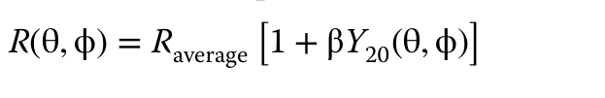
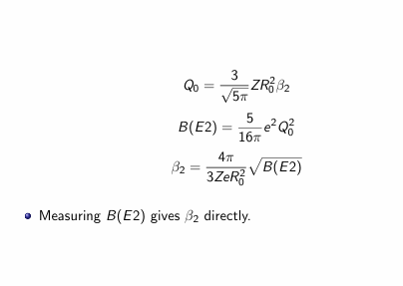
Theory Quadrupole Moments
Quadrupole Moments first needed to be described by the collective expansion of how a nuclear surface is defined.
Along with the estimate for reduced transition probabilities, the quadrupole deformation parameter can be derived. Usually, the first attempt
Key IDEA!!!: needing to use experimental and analytical steps to obtain reduced transition probabilities.

Slide 3
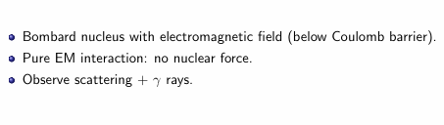
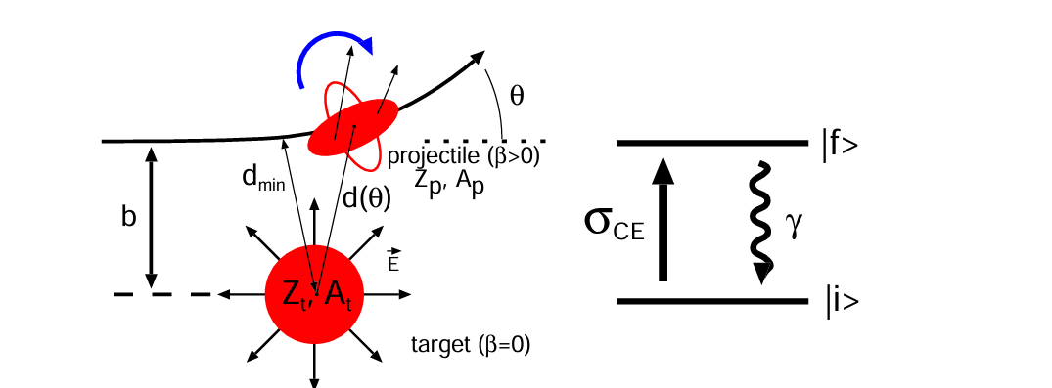
Coulomb Excitation Basics

Slide 4
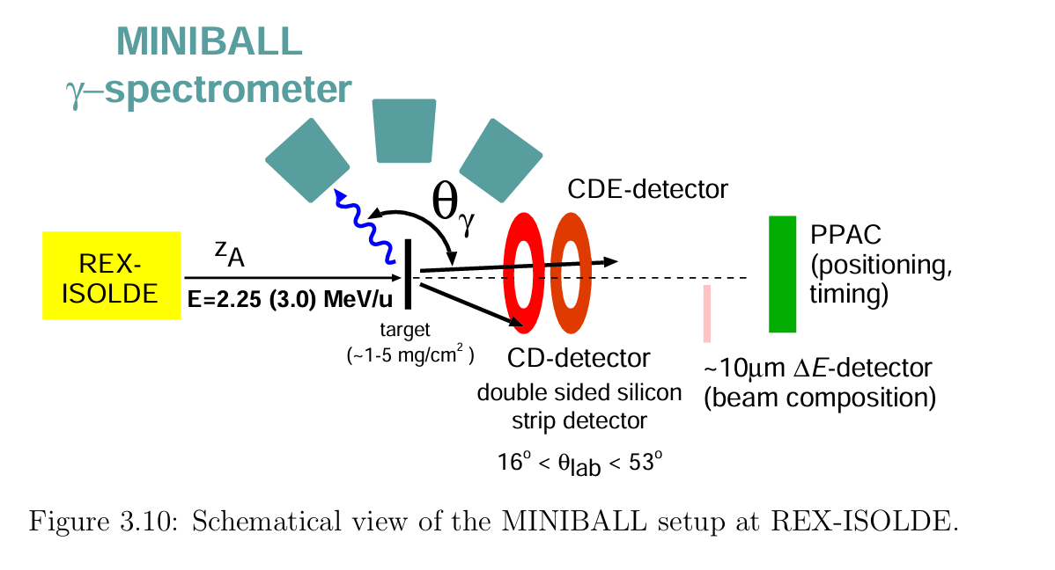
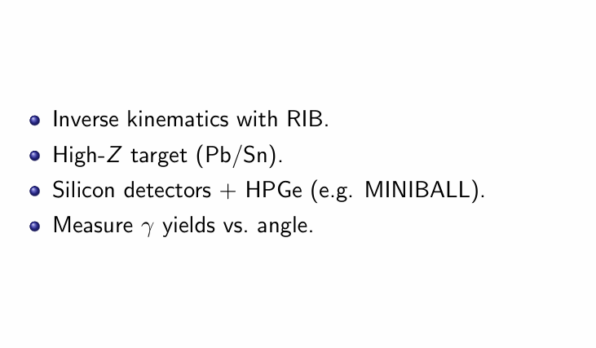
Experimental Techniques

Slide 5

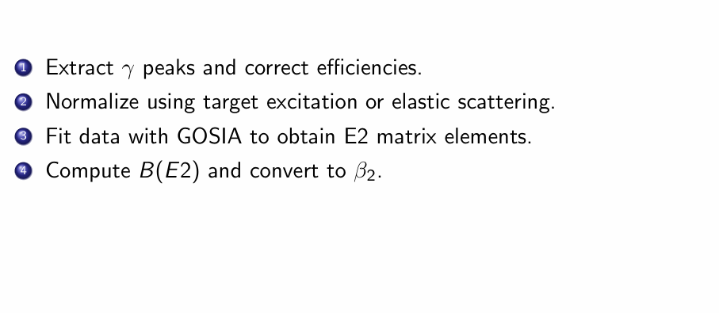
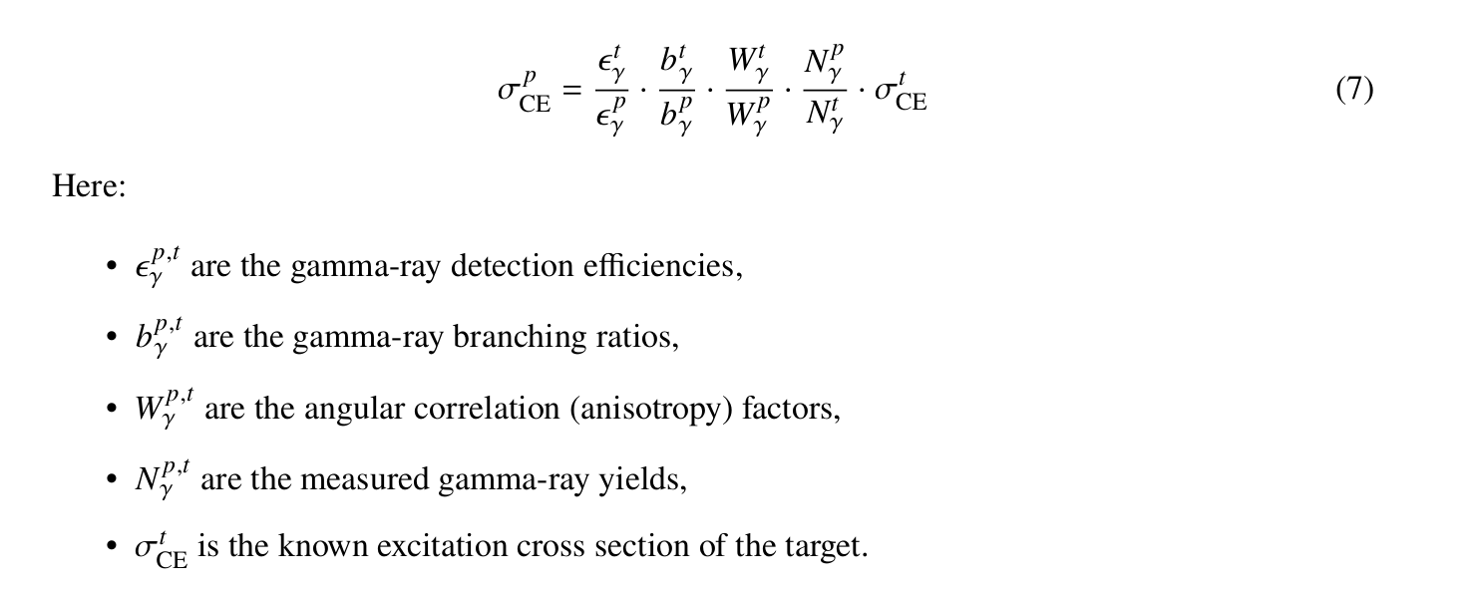

Slide 6
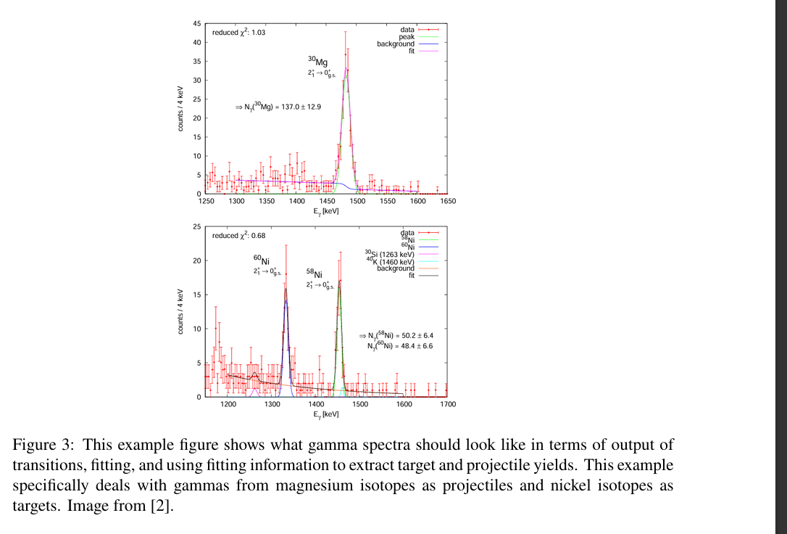
Gamma Extraction & Efficiency
Raw Gamma Spectra that came from the gamma-detector subsystem need to be calibrated, Doppler corrected, and efficiency corrected, along with other steps
At corresponding resonance, particular 2+->0+ transitions can be extracted to get gamma yields.

Slide 7
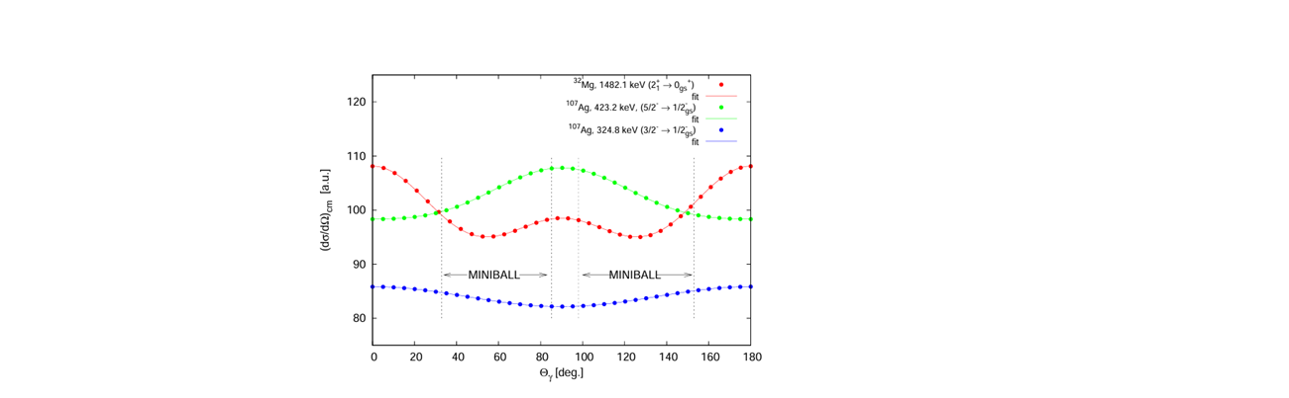
Angular Distribution (W factors)
Using scattering angle binning for each gamma spectra, and simulation including “CLX” angular distributions, such as the differential cross section as a function of scattering angle or specific target or projectile systems.
Ratio between target and or projectile distribution is what determines the w-factor ratio in the earlier equation.

Slide 8
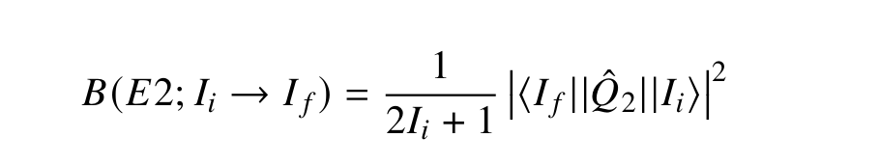
GOSIA Simulations
Simulation tool that takes in experimental inputs including B(E2) from matrix elements that create essentially simulation coulex cross-section that will give you simulated gamma spectra to which goals is to have input match data which if matched then B(E2) is measured.

Slide 9
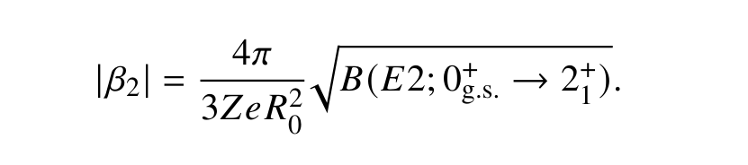
Converting B(E2) into β
β is then obtained from B(E2), since the deformation parameter is proportional to the square root of the reduced transition probability.

Slide 10
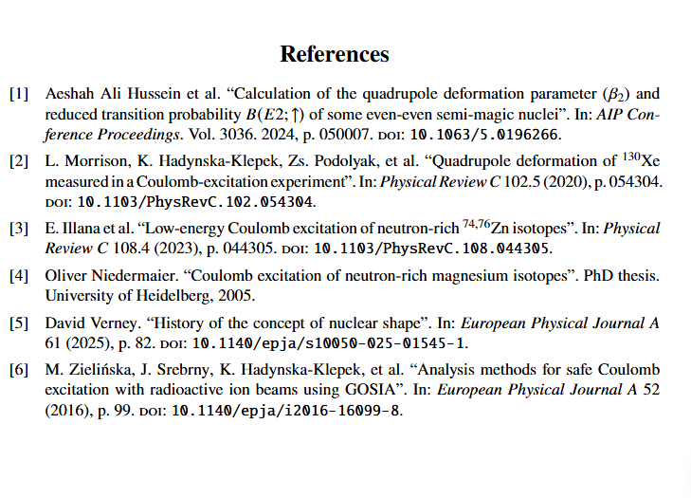
Result Examples of Literature

Slide 11
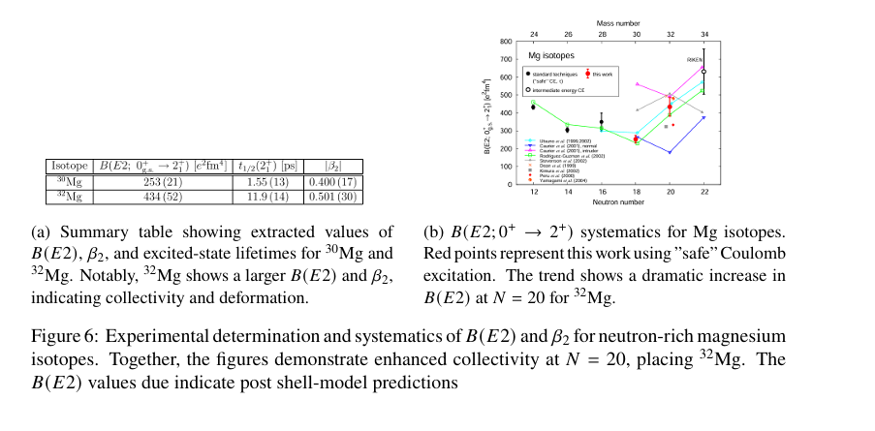

Slide 12
